Slide 1
Mutation testing
Web components

Slide 2


Unit testing
Code
Test
Notes:
What is WC (vs kendo)

Slide 3
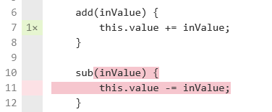
Code coverage
Test
Code coverage
Notes:
It is for you – show u what is not tested
It is for estimation

Slide 4
Code coverage
Test
Code coverage
Notes:
Disadvantages – example of uncovered

Slide 5

Code coverage
Test
Code coverage
Notes:
disadvantages

Slide 6
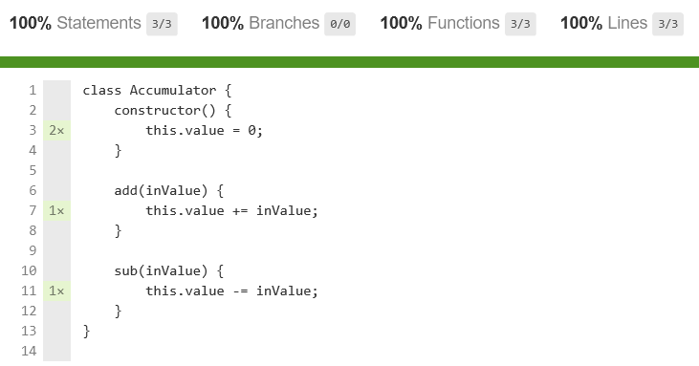
Code coverage
Notes:
disadvantages

Slide 7



Mutant
Code
Code coverage
Notes:
What is WC (vs kendo)

Slide 8
Mutant
Code
Bad test
Good test
Notes:
What is WC (vs kendo)

Slide 9
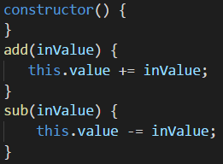
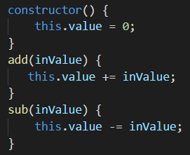
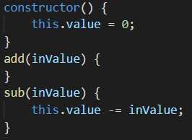
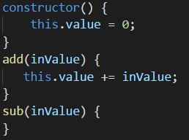
Mutants
Notes:
Let’s create mutant rule

Slide 10

Mutations
Block Statement
Arithmetic Operator
Array Declaration
Boolean Literal
Checked Statement
Conditional Expression
Equality Operator
Logical Operator
String Literal
Unary Operator
Update Operator
Notes:
Let’s create all possible mutants – example

Slide 11
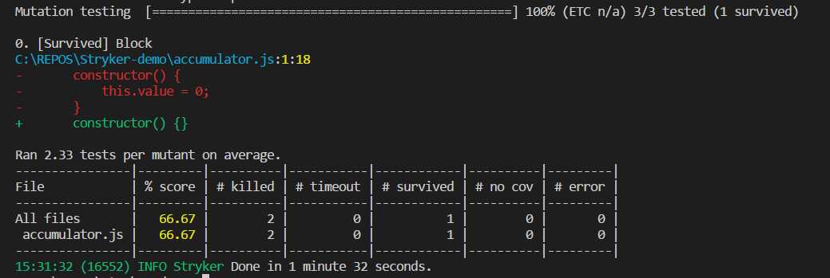
Mutant killing
Notes:
What is WC (vs kendo)

Slide 12
Mutant testing
Notes:
What is WC (vs kendo)

Slide 13
Mutant testing complexity
Notes:
What is WC (vs kendo)

Slide 14
Mutant testing advantages and disadvantages
Notes:
What is WC (vs kendo)

Slide 15


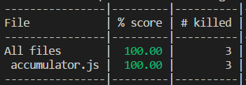
Mutant tests can generate code?
Code
Tests
Notes:
What is WC (vs kendo)

Slide 16
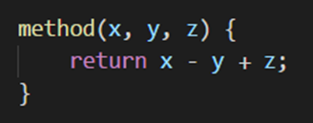
Mutant tests can generate code?
Code
Tests
Notes:
What is WC (vs kendo)

Slide 17

Mutation level
Level 0
Level 1
Level 2
Notes:
What is WC (vs kendo)

Slide 18
Whole level mutation testing
Level 1
Level 2
Level N
Code
mutation
quantity
N
> N*(N-1)/2
…
> 2^N
Test quantity
increase
x2
1..2?
…
0
Test lines
quantity
increase
x4
?
…
0
Notes:
What is WC (vs kendo)

Slide 19
Whole level mutation testing complexity
Notes:
What is WC (vs kendo)

Slide 20
Whole level mutation tests can generate code?
Notes:
What is WC (vs kendo)

Slide 21
Can gyper-mutation tests generate code?
Notes:
What is WC (vs kendo)

